Slide 1
RDBMS - Landscape
Pravin Y Pawar

Slide 2
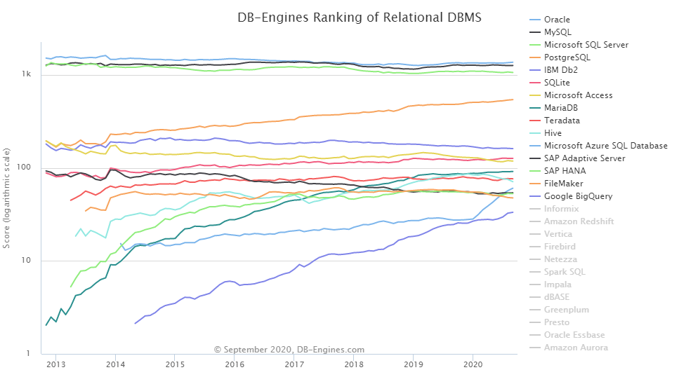
RDBMS Landscape
Source : db-engines

Slide 3


Dominant Players
Commercial Vendors
Open Source Challengers

Slide 4
RDBMS
Advantages
Well-documented and mature technologies, and RDBMSs are sold and maintained by a number of established corporations
SQL standards are well-defined and commonly accepted
A large pool of qualified developers have experience with SQL and RDBMS
All RDBMS are ACID-compliant, meaning they satisfy the requirements of
Atomicity
Consistency
Isolation
Durability

Slide 5
RDBMS
Disadvantages
RDBMSs don't work well — or at all — with unstructured or semi-structured data due to schema and type constraints
Makes them ill-suited for big data analytics
The tables in relational database will not necessarily map one-to-one with an object or class representing the same data
Resulting into mismatch between tables and data structures used in programme
When migrating one RDBMS to another, schemas and types must generally be identical between source and destination tables for migration to work (schema constraint)
Extremely complex datasets or those containing variable-length records are generally difficult to handle with an RDBMS schema

Slide 6
Thank You!
In our next session:

